Slide 2
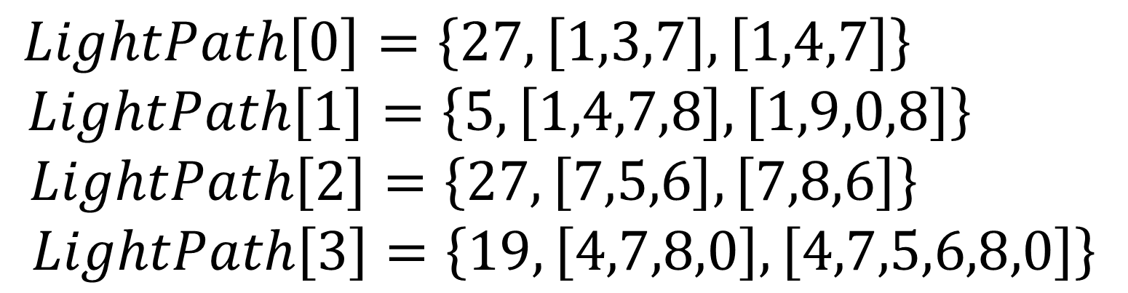
3
$$LightPath\left[0\right]=\left\{27,\left[1,3,7\right],\left[1,4,7\right]\right\}$$
$$LightPath\left[1\right]=\left\{5,\left[1,4,7,8\right],\left[1,9,0,8\right]\right\}$$
$$LightPath\left[2\right]=\left\{27,\left[7,5,6\right],\left[7,8,6\right]\right\}$$
$$LightPath\left[3\right]=\left\{19,\left[4,7,8,0\right],\left[4,7,5,6,8,0\right]\right\}$$
2
1
7
4
5
9
8
6
0

Slide 3
0
0
1-p
p
p
1
1
1-p

Slide 4
Table Look-up
Scrambler
10101101
00101001
10010100
Round 1
+
Table Look-up
Round 2
+
Table Look-up
Scrambler
01010100
00101010
10100010
Scrambler
01000101

Slide 5
a
b
c
d

Slide 6
1
2
7
4
3
6
5

Slide 7
1
3
1
13
2
11
S1
R1
R2
S2
5
6
7
8
9
10
12
3
4
14
4
2

Slide 8
1
3
S1
R1
2
R2
S2
1
3
4
2
4

Slide 9


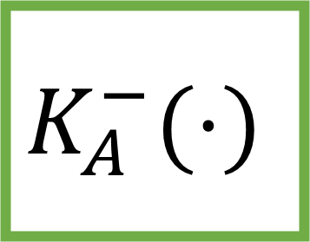

+
$$H(⋅)$$
$$m$$
$$S$$
+
$$K_{A}^{−}(⋅)$$

Slide 10
1
2
3
4
2
4
1
3
3
1
4
2
4
3
2
1

Slide 11
Output 1
Output 2
Output 3
Output 4
1,2,3
1,2,3
1,2,3
1,2,3

Slide 12
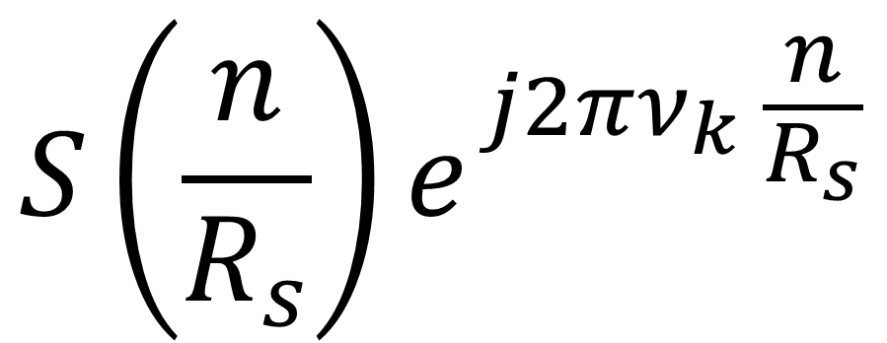
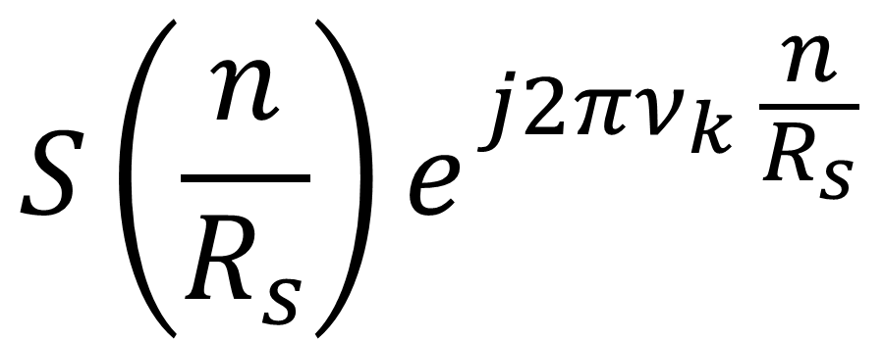
$$S\left(\frac{n}{R_{s}}\right)e^{j2πν_{k} \frac{n}{R_{s}}}$$
$$S\left(\frac{n}{R_{s}}\right)e^{j2πν_{k} \frac{n}{R_{s}}}$$
$$a⋅sinc\left(t\right)+b⋅sinc\left(t\right)e^{j2π100t}$$
$$a⋅sinc\left(n\right)+b⋅sinc\left(n\right)e^{j2π100n}=\left(a+b\right)sinc(n)$$

Slide 13
Upsampler
Exponential
Exponential
Upsampler

Slide 14


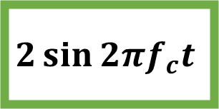
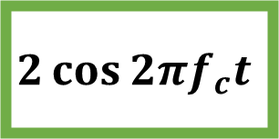

$$2\cos{2{πf}_{c}t}$$
$$Y(t)$$
$$×$$
Low-Pass Filter
RRC pulse shape
Downsampler
Channel output
Dispersion compensator
+
Symbol-to-bit converter
Decoded bit stream
$$×$$
Low-Pass Filter
RRC pulse shape
Downsampler
$$2\sin{2{πf}_{c}t}$$

Slide 15





$$\cos{2{πf}_{c}t}$$
$$S(t)$$
Upsampler
RRC pulse shape
$$×$$
In-Phase
Uncoded bit stream
Bit-to-symbol converter
+
Channel input
Quadrature
Upsampler
RRC pulse shape
$$×$$
$$\sin{2{πf}_{c}t}$$

Slide 17
Tx. Output
Optical Detector
Channel Output
+
Optical Fiber
White Gaussian Noise

Slide 18
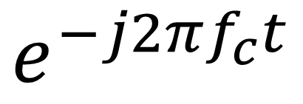

EDC
$$×$$
Analog LPF
DownSample(M)
RRC
$$e^{−j2πf_{c}t}$$

Slide 19
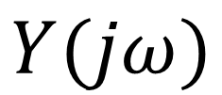

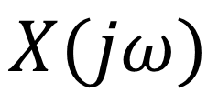

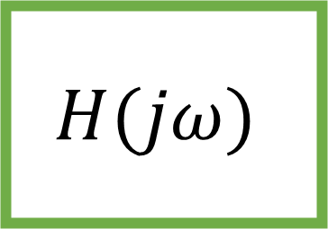
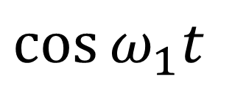
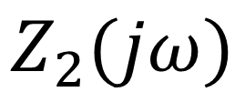
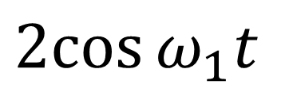
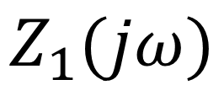
$$×$$
$$×$$
$$H(jω)$$
$$X(jω)$$
$$Y(jω)$$
$$Z_{1}(jω)$$
$$Z_{2}(jω)$$
$$\cos{ω_{1}t}$$
$$2cos{ω_{1}t}$$

Slide 20
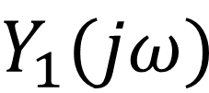


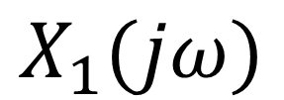
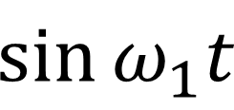


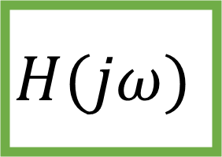
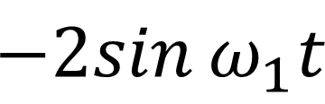
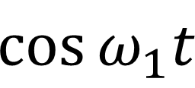
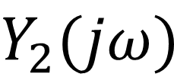

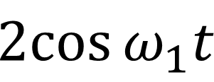

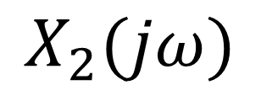
$$\cos{ω_{1}t}$$
$$2cos{ω_{1}t}$$
$$H(jω)$$
$$×$$
$$Y_{1}(jω)$$
$$X_{1}(jω)$$
$$×$$
$$+$$
$$X_{2}(jω)$$
$$×$$
$$H(jω)$$
$$×$$
$$Y_{2}(jω)$$
$$\sin{ω_{1}t}$$
$$−2sin{ω_{1}t}$$

Slide 21
2
3
1
4
5
8
6
7

Slide 22
-3
b
e
4
6
a
1
f
2
5
1
c
d

Slide 23
3
b
e
-2
4
d
1
5
f
a
7
2
c

Slide 24
5
b
e
0
6
d
3
7
f
a
9
4
c

Slide 25
2
5
1
1
1
1
1
3
7
1
1
1
2
4
1
6

Slide 26
2
5
1
1
1
1
1
3
7
-1
-1
1
2
4
1
6

Slide 27
2
5
1
1
1
1
1
3
7
-1
-1
1
2
4
1
6

Slide 28
2
5
1
1
1
1
1
3
7
1
1
1
2
4
1
6

Slide 29
2
5
1
3
7
4
6

Slide 30
2
5
1
1
1
1
1
1
1
1
3
7
1
1
1
1
1
1
4
6
1

Slide 31
2
5
1
0
1
1
1
2
0
0
1
3
7
2
2
0
1
2
0
4
6
2

Slide 32
2
5
1
1
1
1
1
1
1
1
1
3
7
1
1
1
1
1
1
4
6
1

Slide 33
2
5
1
0
1
1
1
2
0
0
1
3
7
2
2
0
1
2
0
4
6
2

Slide 34
2
5
1
0
1
1
1
2
0
0
1
3
7
0
2
2
0
4
6
2

Slide 35
B
C
A
X1
X2
Z
D
E
F
G

Slide 36
A
2600
G
1500
200
1100
2600
2400
400
C
1100
F
200
1100
E

Slide 37
A
2600
G
1500
200
1100
2600
2400
400
C
1100
F
200
1100
E

Slide 38
A
G
1500
200
C
F
200
1100
E

